Slide 1

Feline Rescue
Annual Meeting
May 15, 2021 edited June, 2021 to Match Audited Financial Statements

Slide 2
Agenda
President’s Report: Elaine Grittner, President
Voluntary Reporting: Sharon St. Mary, Secretary
2020 Financial Information: Lisa Goddard, Treasurer
Development: Rob Nordin, Development Chair
Events: Kaylen Broms, Events Chair
Social Media: Hillary Robertson, Social Media Chair
Why Fostering Matters: Beth Varro, Foster
Challenges: Elaine Grittner
Q & A with Executive Director: Phil Manz
Notes:
Elaine

Slide 3
Meet our Board Members
Rob Nordin
Sharon St. Mary
Chuck Selcer
Michelle Guion
Lisa Goddard
Elaine Grittner
The Nominating Committee is always open to receiving board nominations. Apply here: https://felinerescue.org/board-of-directors-candidate-interest-form/
Notes:
Elaine

Slide 4

Significant Events of 2020
Onset and continuation of COVID-19 pandemic
Outstanding volunteer response, moving 26 cats from shelter to foster
Our foster program grew as shelter was closed
One day, we will be back to a place where we can worry about cat overpopulation again. Right now, it's all hands-on deck to keep people alive. – Minnesota Department of Health, April 2020
Notes:
Elaine

Slide 5
Operations during COVID-19
Significant upheaval
Shelter Operations scaled back and then closed
All Shelter cats adopted or moved to Foster
Adoptions temporarily halted due to social distancing
Emergency Intake continues
Non-essential veterinary procedures halted
Fundraising events cancelled or re-imagined
Produced voluntary COVID-19 Preparedness Plan based on MN Dept of Labor guidelines
Notes:
Elaine
Make sure sick workers stay home
Increase social distancing by ensuring workers stay at least six feet away from each other
Worker hygiene and source control
Cleaning and disinfection protocols

Slide 6
Significant Events of 2020, CONT'D
  Challenges of communicating with limited face-to-face time
  Acceptance of government funds
  New committee members
    Events – Kaylen Broms
    Social Media – Hillary Robertson
    Secretary of Board of Directors – Sharon St. Mary
Cats multiplying in metro back yards as pandemic reduces animal control reach.
- St. Paul Pioneer Press, April 2021
Notes:
Elaine

Slide 7
Significant Events of 2020, CONT'D
Challenges with hiring a certified veterinary technician
Expanded the use of videos to tell our story
In February we added a Volunteer Assistance Program, for help with life’s challenges
  If you need help, call 1-866-326-7194 or visit www.hpeap.com
  PW: feline
In the past, we suspended operations in the shelter due to a cat disease...now, we have a human disease.
Notes:
Elaine

Slide 8
VOLUNTARY REPORTING
  We share data with several organizations:
    Charities Review Council
    GiveMN
    Network for Good
    Guidestar
    Charity Navigator
    Shelter Animal Counts maintains The National Database of shelter (and foster) animal statistics, providing facts and enabling insights that save lives.
Notes:
Sharon
Charities Review Council partners with nonprofit leaders to build and communicate their organizations’ internal strengths.
Our previous Meets Standards License expired on May 5, 2021 and our current license is under review.
We will submit our information after the current financial audit is approved at the next Board Meeting.
We authorize CRC to submit our information to GiveMN the organizers of Give to the Max in November, Network for Good and other nonprofit partner organizations.
Guidestar connects donors with the nonprofit information they need.
We are behind in posting information here but expect to get caught up this summer.
Charity Navigator is a charity assessment organization that evaluates hundreds of thousands of US-based charitable organizations.
We will be evaluated by them beginning next year, because our revenue will be greater than $1,000,000 for two years in a row.
Shelter Animal Counts maintains The National Database of shelter (and foster) animal statistics, providing facts and enabling insights that save lives.
Feline Rescue began reporting to SAC in 2017
In 2021, SAC is starting to measure community services such as distribution of pet food, pet supplies, grooming (such as our Cat Claw Clipping Clinics), temporary housing for animals (something we would like to do) and other pet retention services, such as the calls outreach director Vickie Lachelt has made over the years

Slide 9
Shelter animal counts (SAC)
Numbers indicate cats and kittens in both the shelter & foster programs.
 | Intake |  |  |  | Live Outcomes |  |  | Other Outcomes
 | Stray / At Large | Relinquished by Owner | Transferred In | Other intakes | Adoption | Returned to Owner | Transferred Out | Died In Care | Shelter Euthanasia
2019 | 84 | 67 | 477 | 91 | 840 | 80 | 8 | 9 | 33
2020 | 54 | 51 | 265 | 42 | 468 | 11 | 6 | 4 | 9
2021 YTD | 13 | 23 | 81 | 39 | 106 | 0 | 0 | 4 | 5
Notes:
Sharon
Descriptions of Intakes:
Stray/At Large – Stated to be unknown or free-roaming
Relinquished by Owner - KA Surrenders: Admitted by owner, including adoption returns. A
Transferred in From Agency
Other Intakes – Cats born while in care and types not mentioned elsewhere

Slide 10
Finance Monitoring
As of December 2020, Audited as of 12/31/2020
Investments | 1,447,000
Property and Equipment | 1,007,000
Short Term Assets | 480,000
Total | 2,934,000
Committee Meeting Frequency
Finance / monthly
Investment / quarterly
Notes:
Lisa
2020 Audit to be finalized after the next Board Meeting and then posted on the website.
IRS 990 form is forthcoming and will be posted online when ready.

Slide 11
Financial Results
Revenue / Expense | 2018 | 2019 | 2020 | 2021 Projection
Recurring Revenue | 540,000 | 548,000 | 485,000 | 485,000
Expenses | 973,000 | 945,000 | 742,000 | 1,000,000
Net Income | (433,000) | (397,000) | (257,000) | (515,000)
Investments | (117,000) | 173,000 | 142,000 | 100,000
Non-Recurring Revenue | 113,000 | 271,000 | 725,000 | 550,000
Final Result | (438,000) | 48,000 | 400,000 | 135,000
Notes:
Lisa

Slide 12
Terms in financial Results
Recurring Revenue
    Adoptions, net of returns
    Cat Claw Clippings
    Recurring Individual Contributions
    Corporate and Foundations (99% Triggered by Individuals)
    Memorials and Sponsorships
    Special Events we sponsor (net of direct expenses)
    Investment Income (net of all investment fees)
Notes:
Lisa

Slide 13
Terms in financial Results
Non - Recurring Revenue
    Grants
    Special One Time Giving
    Estate Giving
    Estate Giving Designated for Endowments
    In Kind Contributions
    Government COVID Relief Funds
Notes:
Lisa

Slide 14
Challenges and Decisions
Our revenue sources are unique in that much of this revenue is non-recurring:
    Estate gifts - we know of at least 30 planned estate gifts
    Leadership giving
    Government (2021)
Establish a policy for maintaining six months of operating reserves.
No funds needed from endowments.
Notes:
Lisa

Slide 15
A Community Where Every Cat is Wanted
Cats Adopted, 1997 - 2021
1997 | 2008 | 2014 | 2015 | 2017 | 2020 | 2021 YTD
115 | 245 | 592 | 741 | 1,119 | 468 | 106
Estate Gifts
Anonymous Estate
Anonymous Leadership
Mark Rude Estate
James Vculek Estate
fund present and future operating deficits
1997
2008
2015
2017
2014
2020
2021
Pat Potter Estate Alan Macker Estate retire debt from 593 building purchase in 2006
Peter Sanders Trust starts General Endowment
- - - - - - - - - - - -
David Jones Trust
funds operating deficit
Multiple smaller estates enable purchase of 600 building
Sharon K Warner Trust
starts Medical Endowment
Currently Anonymous
Estate funds operating deficit
Founded by 22 volunteers
Known Donors (excluding Adopters)
2010 | 2011 | 2012 | 2013 | 2014 | 2015 | 2016 | 2017 | 2018 | 2019 | 2020 | 2021 YTD
1,382 | 1,234 | 1,570 | 1,744 | 1,965 | 1,889 | 1,938 | 2,157 | 1,995 | 1,947 | 2,379 | 812
Notes:
Rob

Slide 16
2020 Development Highlights
    Continued support from recurring donors
    $135,000 from an anonymous donor
      Fire alarms for 593 and 600 Fairview
      Enhanced parking lot lighting
      Website redesign
      Veterinary services
    $592,000 from Estates
    $30,000 was restricted to endowments only
Notes:
Rob

Slide 17
2020 DEVELOPMENT HIGHLIGHTS
    Estate gift truism:
        90% of estate gifts come from out of the blue.
We shared giving story videos on our website to publicize estate giving.
Notes:
Rob
Estate gifts represent moving Feline Rescue to the level of family.
If that premise is true, then we know 300 people have put us in their estate plans.

Slide 18
2020 Event Highlights
Cat Claw Clipping Clinics
Cat VideoFest with the Minneapolis/St. Paul Film Festival
    Pop-up cat food drives
    Cat Calendar Contest
    Kitten Shower
    Give to the Max
    The Events Committee is looking for new members –
    email Kaylen.Broms@felinerescue.org for more information.
Notes:
Kaylen
CCCCs take place at 9 area Chuck & Don’s locations. In 2020, we clipped claws for about 480 cats. In 2019, we helped 2,160 cats – or 38,880 nails clipped (2160 cats x 18 nails/cat)

Slide 19
2020 social media Highlights
    Not much social media presence in early 2020
      Events & Cat Claw Clipping Clinics
        The 2020 Cat Calendar Contest began a more concerted effort with social media
        Website revamp planning began
        Give to the Max
          Featured an amazing video by Jenni Charrier of Foxhill Studios
Notes:
Hillary
Our social media seemed fizzled out, with only events and cat claw clipping clinic notifications.
Running the Cat Calendar Contest last year made me realize that there was no organized social media presence, so I removed former volunteers from our Facebook account and began developing a social media plan.
Running the social media for Give to the Max (with 2 days' notice!) was an exhausting blast! Jenni's video starring the incomparable Hamilton & Burr, was a hit, and the graphics (designed on the fly by my husband) were fun and eye-catching.
Talked to Brooke Brose, who has done some social media for us. We came up with a general plan and several social media volunteers were recruited.
Social Media works closely with Events, creates marketing materials, posts and monitors the social media feed on FB/Insta. We look forward to partnering with Development on future fundraising efforts.
After Give to the Max, I thought my next challenge should be updating the FR website, which was very formal and hardly had any cat pictures. I developed a plan and with the generous support of donors, we transformed the website into a friendlier and more informative space.
Emily Resar and her husband are working on coding a photo crawl for the front page of the website, since that was high on the website wish list. They also updated the formatting on the Available Cats page, and it looks amazing!
I'm really pleased with how the website turned out, and grateful for the volunteers who offered feedback. I'm also thrilled that Kellie Nitz has trained in on how to update the website so we can tag-team on things like updating the Alumni Updates, which just might be my favorite part of the website!

Slide 20
2020 social media Highlights, cont'd
          Jenni Charrier of Foxhill Studios created the following videos, which can be found on our News page:
              Founders, featuring a brief history of the founding of Feline Rescue
              Estate Gift, explaining why a donor chose to bequeath a gift to us
              Volunteer Appreciation, in which our volunteers talk about resilience and why they love volunteering here
              UMN Student Project, where student filmmakers supervised by Jenni talked to fosters and adopters about why they love supporting Feline Rescue
Notes:
Hillary
One of the best parts of 2020 was seeing the amazing work Jenni Charrier did for us! While the rest of us couldn’t do much, Jenni of Foxhill Studios went to work big-time!
Founders video – a delightful walk down Feline Rescue's Memory Lane
Estate Gift – moving tribute by the donor's friends
Volunteer Appreciation – the challenges of volunteering during Covid
Student Project – highlights the work fosters do to prepare their wards for their best life, and the adopters who appreciate all they do
INTRODUCE BETH! Beth Varro began fostering cats last October. She grew up with dogs and had done significant cat sitting before fostering. Now, she may be hooked! She’s here to share a little about her experiences in the past 8 months.

Slide 21
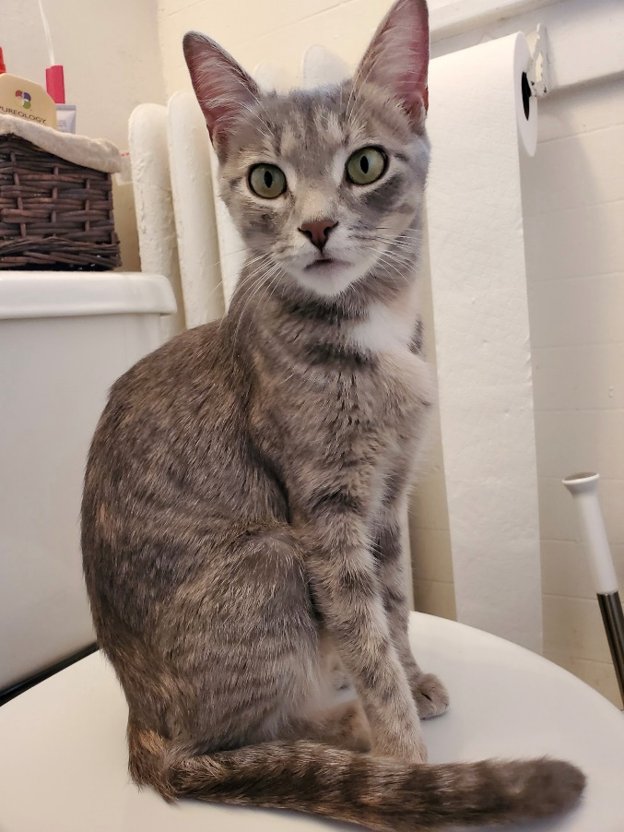
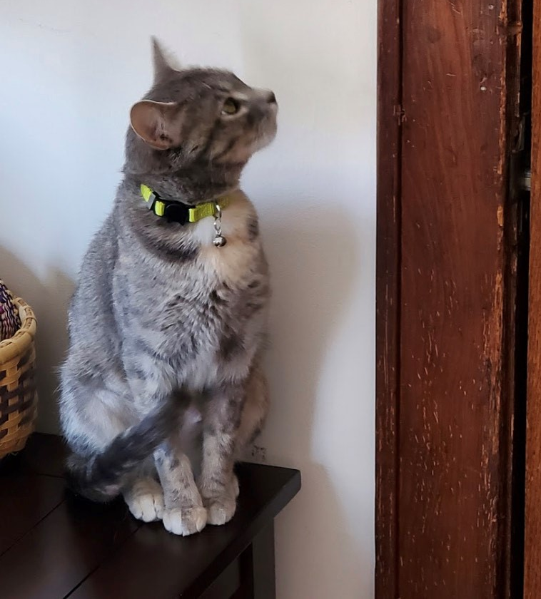
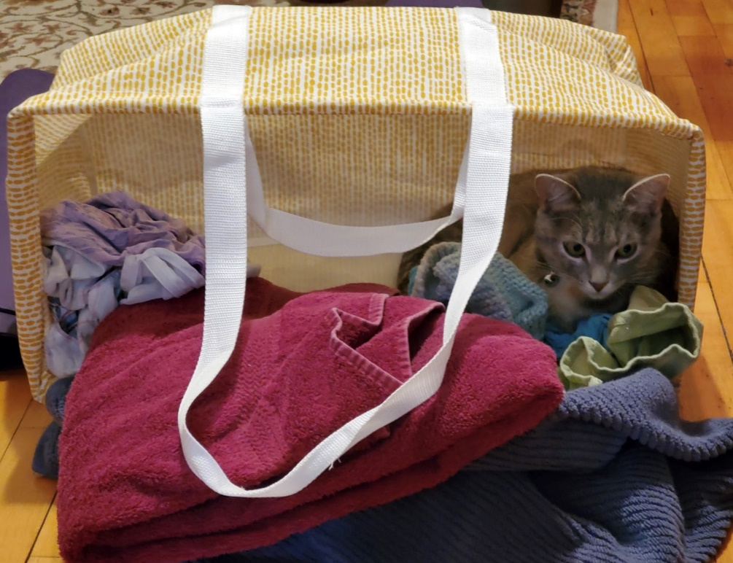
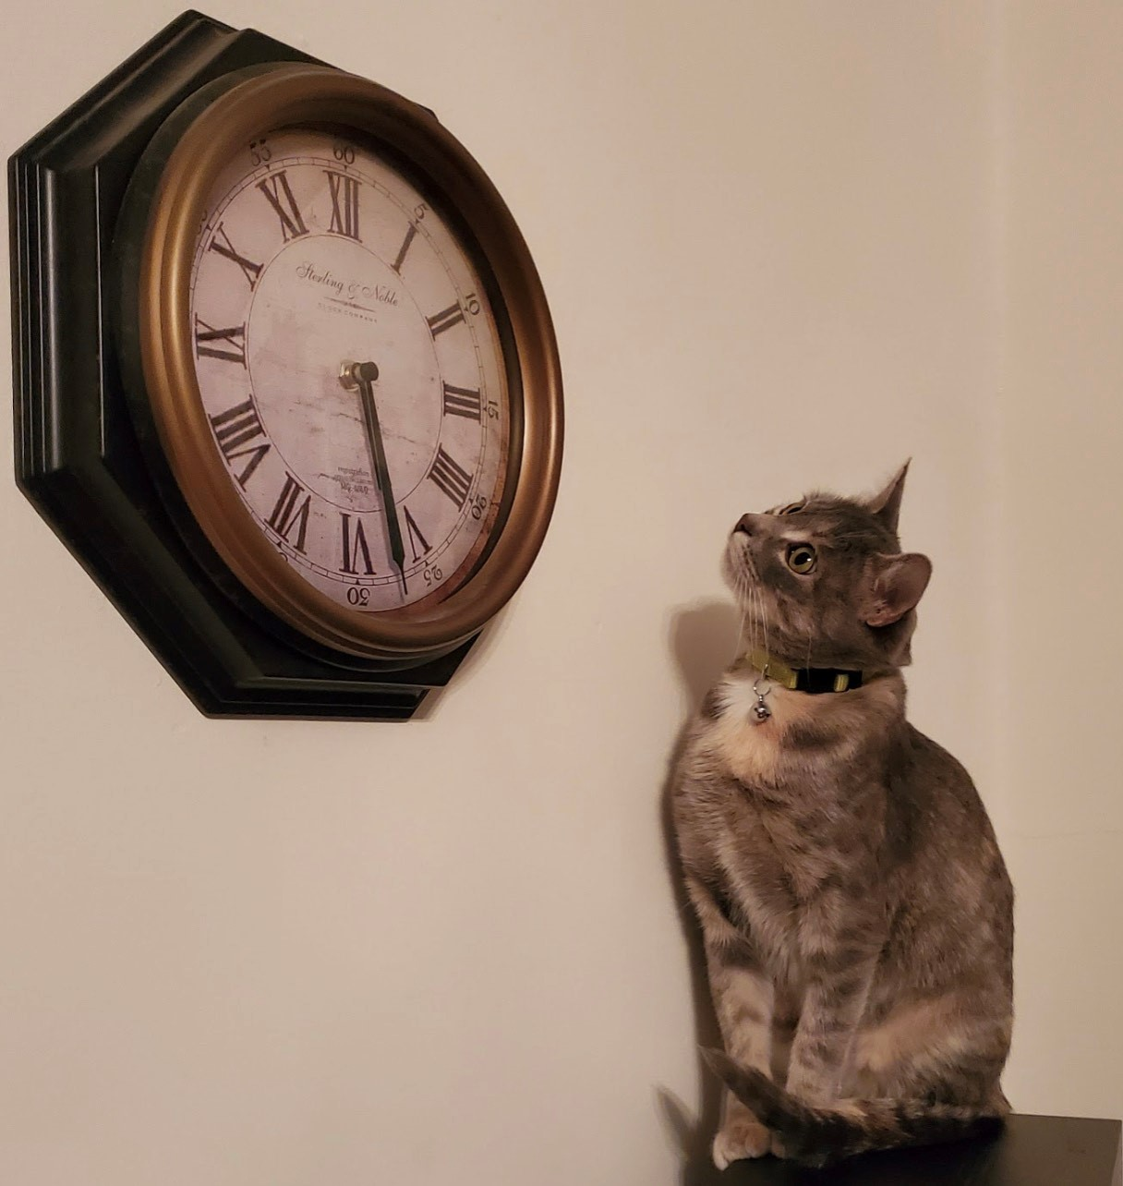
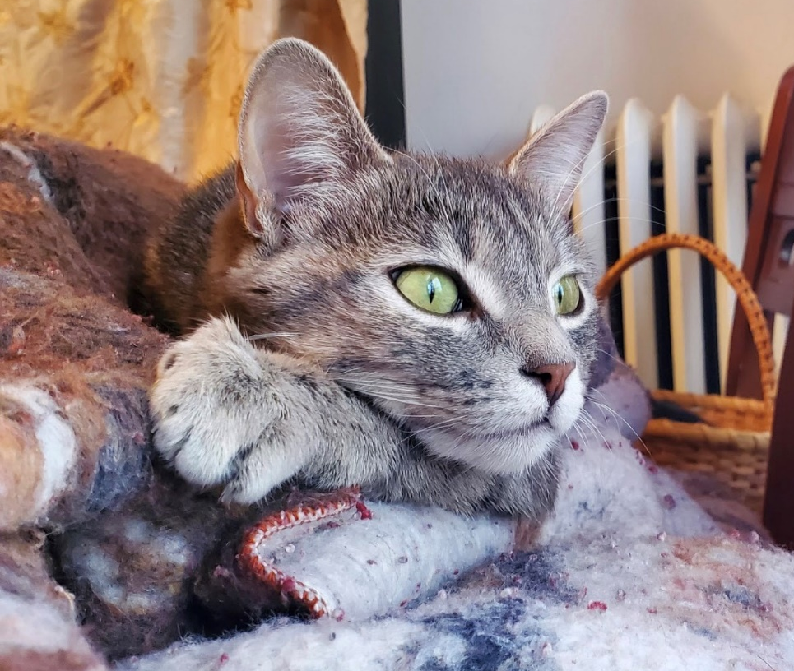
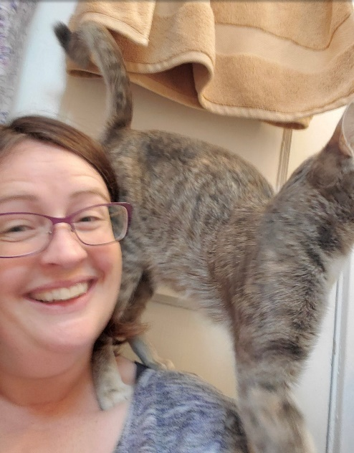
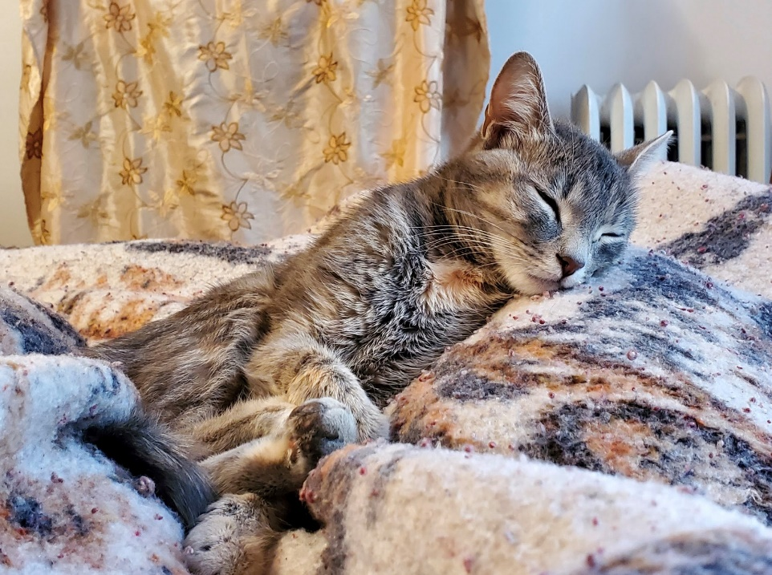
Why fostering matters
Chloe
Notes:
Beth

Slide 22
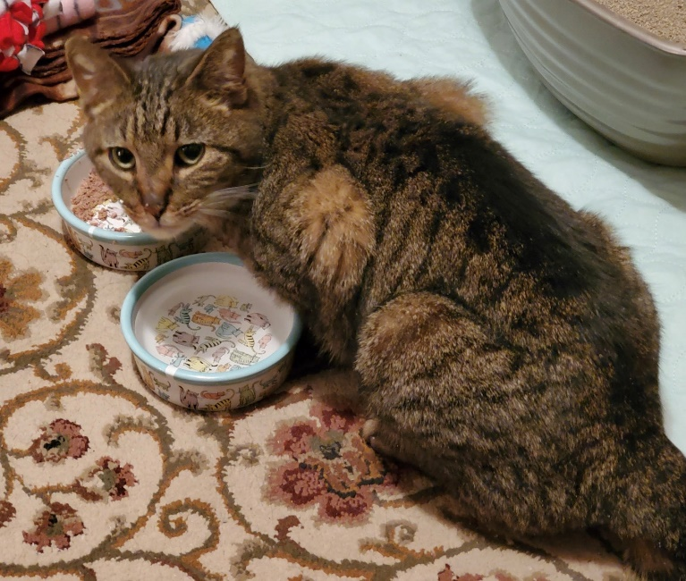
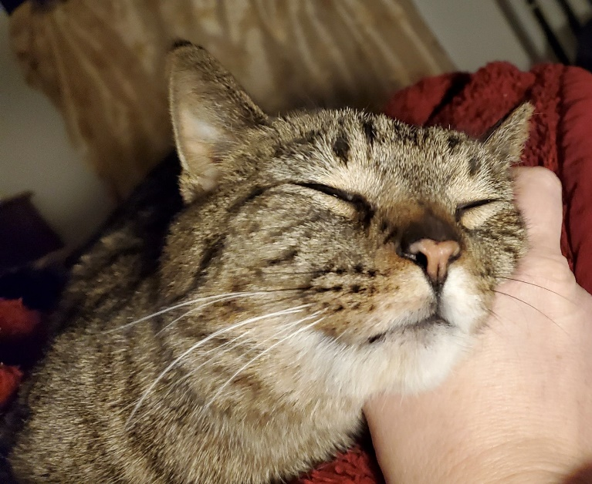
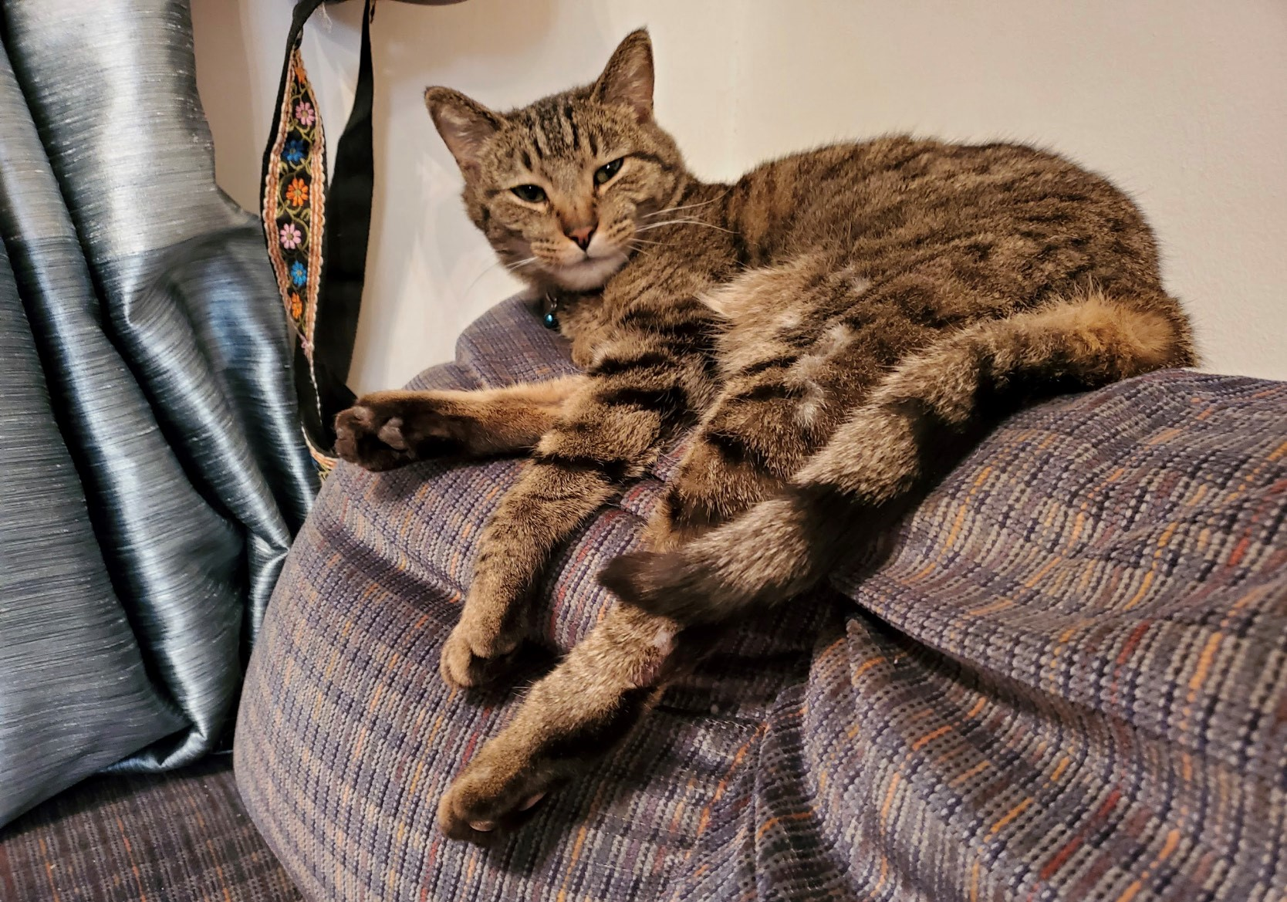
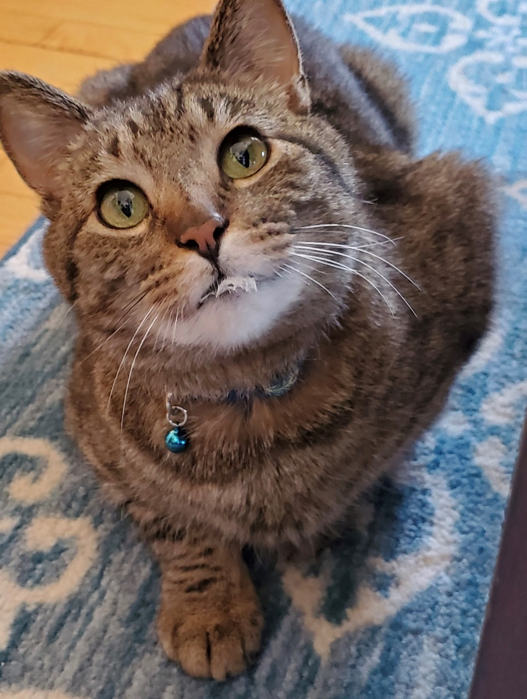
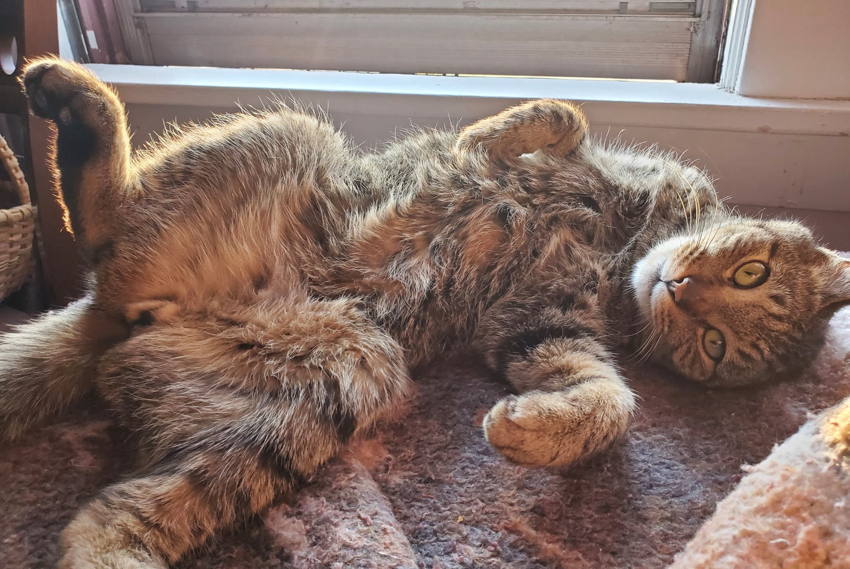
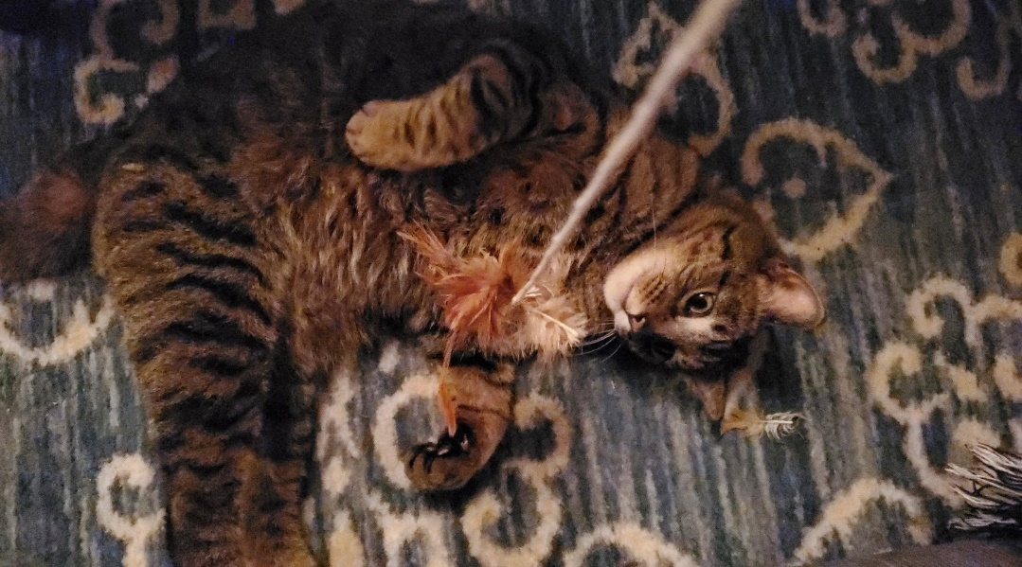
Why fostering matters
Poe
Notes:
Beth

Slide 23
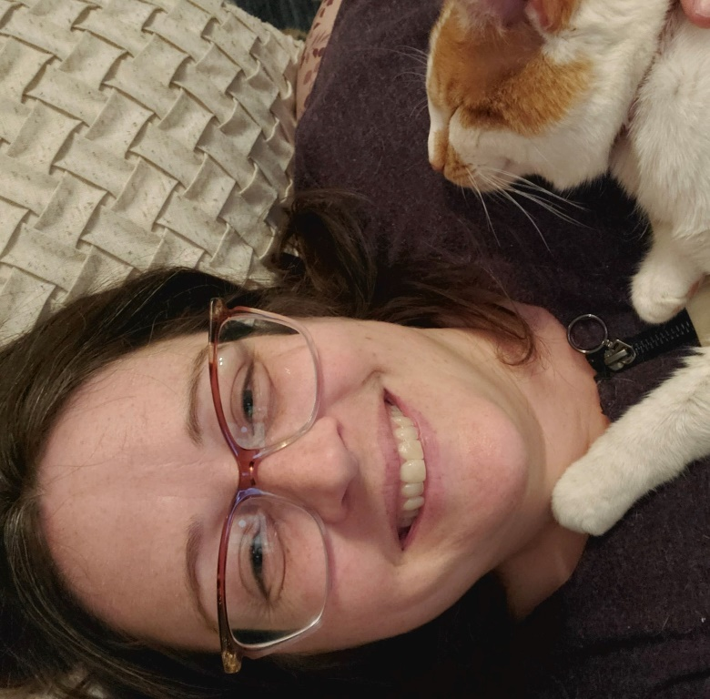
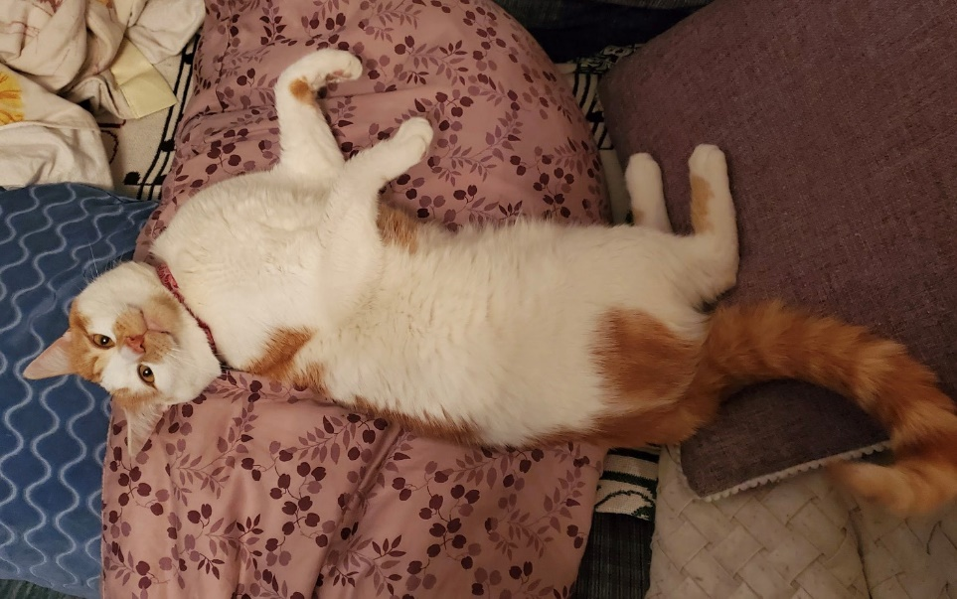
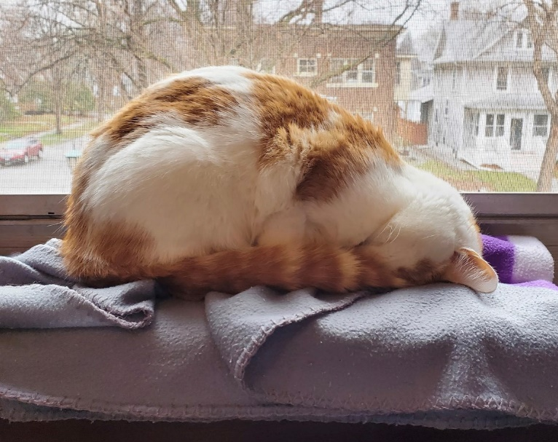
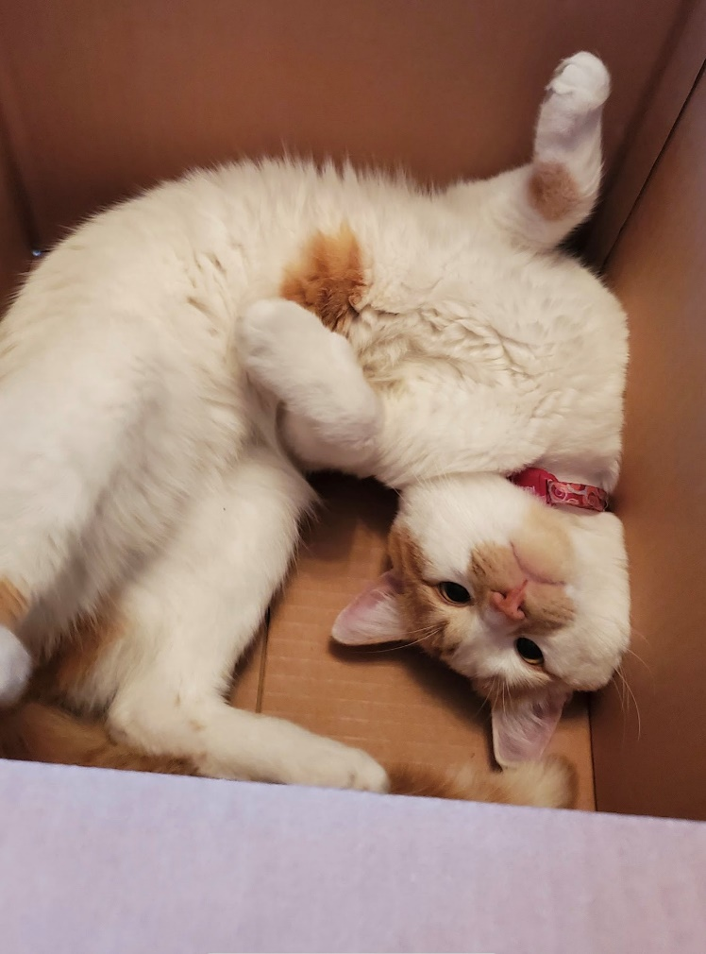
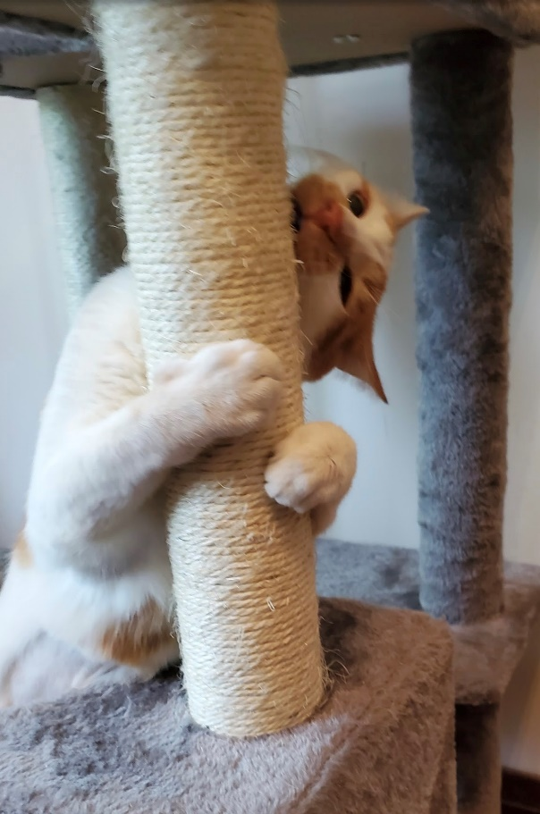
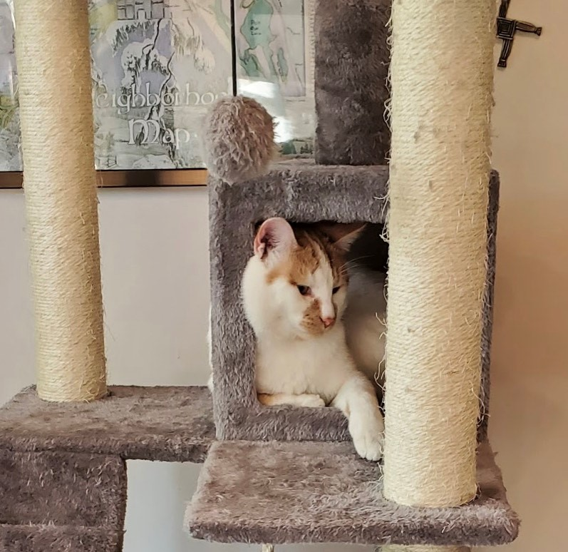
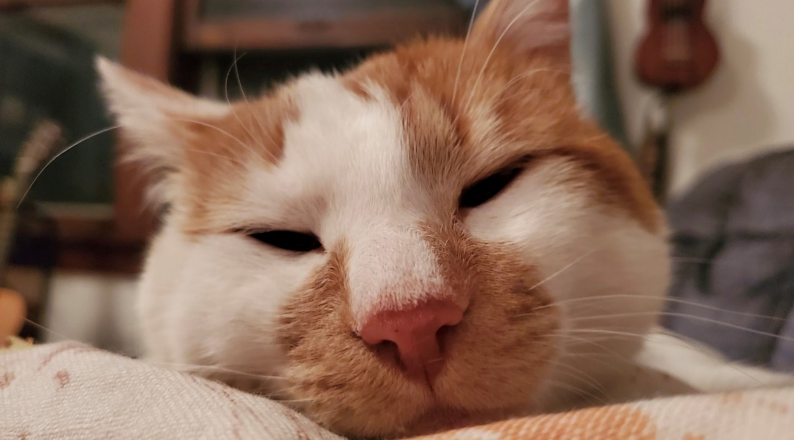
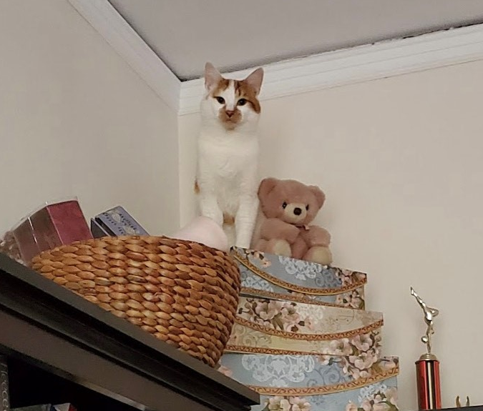
Why fostering matters
Rutherford
Notes:
Beth

Slide 24
Challenges
Get the shelter up and running
Recruiting an Operations Manager
Addressing the Vet Services Backlog
Increasing Diversity
Our walls are dedicated to newspaper articles, pictures of cats, and the list of founders
  Develop permanent, visible donor recognition programs
  We have no named buildings, rooms, giving clubs, or listings in annual reports
  Enhance online donor recognition
Notes:
Elaine

Slide 25

Q & A
  Submit questions using Chat function
  or
  email Phil.Manz@felinerescue.org to talk offline.
Notes:
Phil
If you'd like to have a followup discussion, please email me.

